Slide 1
EUMETSAT Satellite Data Records for Reanalysis
Jörg Schulz, Tim Hewison, Rob Roebeling, Roger Huckle
Acknowledgements: Julia Figa, Christian Marquardt, Rüdiger Lang, Lothar Schüller, Bertrand Theodore

Slide 2
Content
EUMETSAT Space Segment and Mandate
Data Record Generation Plan
ERA-CLIM Records from EUMETSAT EPS System
Towards a Geostationary Fundamental Climate Data Record
Conclusions

Slide 3
EUMETSAT Space Segment
YEAR...
00
01
02
03
04
05
06
07
08
09
10
11
12
13
14
15
16
17
18
19
20
21
22
23
24
25
26
27
28
29
30
31
32
33
34
35
36
37
38
39
40
METEOSAT FIRST GENERATION
Meteosat First Generation Data Coverage starts in 1981
METEOSAT-6
METEOSAT-7
METEOSAT SECOND GENERATION
METEOSAT-8
METEOSAT-9
Launch date 19 June 2012
METEOSAT-10
METEOSAT-11
METEOSAT THIRD GENERATION
MTG-l-1
MTG-S-1
MTG-l-2
MTG-l-3
MTG-S-2
MTG-l-4
EUMETSAT POLAR SYSTEM (EPS)
METOP-A
Launch planned for mid July 2012
METOP-B
METOP-C
EPS SECOND GENERATION
Jointly with:
OCEAN SURFACE TOPOGRAPHY MISSION
JASON-2
JASON-3
JASON CONTINUITY OF SERVICES (CS)
THIRD-PARTY PROGRAMMES
ESA/European Commission Missions
operated by EUMETSAT
GMES SENTINEL-3
GMES SENTINEL-4 ON MTG
GMES SENTINEL-5 ON EPS SECOND GENERATION
Notes:
EUMETSAT programs are long term. Thus they are sustainable.
Mandatory and optional programs as well as EC missions carry many ocean relevant instruments.

Slide 4
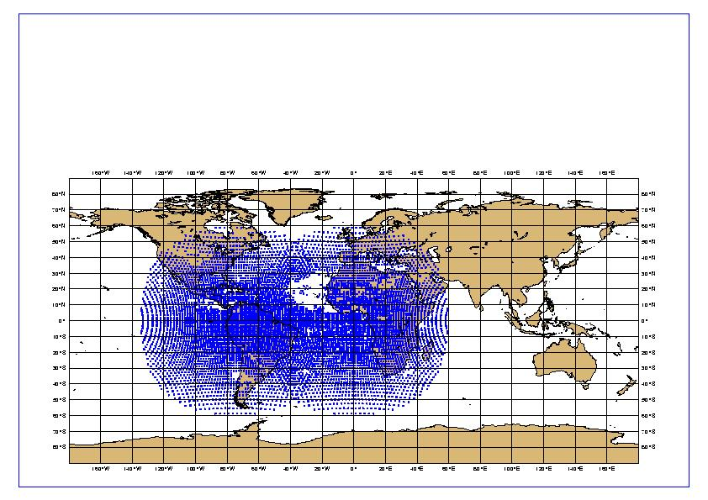
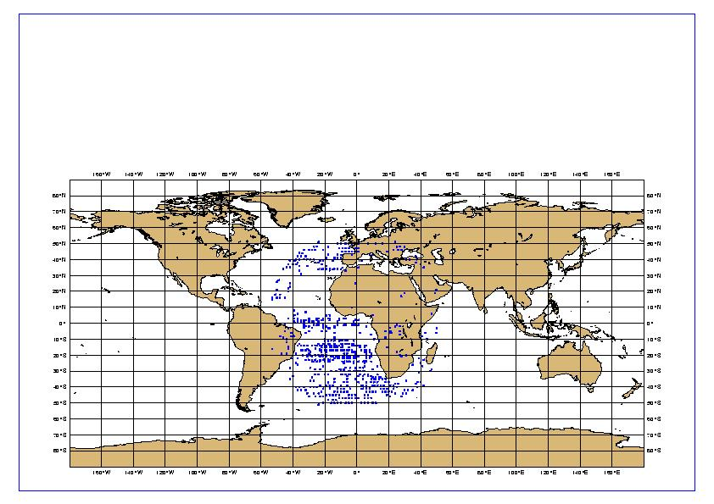
Historical Context – Products and Customers
Reprocessing of long-term data of Meteosat Atmospheric Motion Vectors was an important contribution to Re-analyses at NWP Centers in particular ECMWF:
=> Substantially improved coverage and impact of re-processed winds from Meteosat satellites (C. Desol, ECMWF, 2008)
Period corresponds to time when Meteosat-5 was operational at 0º and Meteosat-3 supported NOAA because there was only one GOES satellite.
All activities were performed on best effort basis.
Example of coverage: 19950102
Reprocessed Met3 and Met5
Original Met5
Notes:
Experience from last ECMWF reanalysis has shown that reprocessing of satellite raw data pays of!
So we are continuing and extending it within the EU FP-7 project ERA-CLIM
EU FP-7 ERA CLIM project to prepare ECMWF E20C reanalysis:
Generation of consistent AMV and CSR products for Meteosat 2 – 9 (covering 1982 – 2010) – Delivery September 2012;
Generation of Metop AVHRR Atmospheric Motion Vector – Delivery December 2012;
Generation of consistent radio-occultation data (bending angles) back to 2001 from GRAS, CHAMP, GRACE and COSMIC sensors – Delivery December 2012;
Consistent total ozone from combined GOME-2 and IASI observations – Delivery December 2013;
First reprocessing of all Metop data including ASCAT (soil moisture, surface ocean wind) – Delivery December 2013.

Slide 5

EUMETSAT’s Climate Monitoring Implementation Plan
EUMETSAT Convention (November 2000):
Commitment to support Climate Monitoring and Climate Change Detection
Council Resolution (July 2009):
Consideration of Climate requirements in programme preparation
Generation of Climate Data Records (CDR) Fundamental and Thematic (FCDR+TCDR)
Internal and external coordination and communication
GSICS / SCOPE-CM
SAF
Climate Monitoring Implementation Plan (July 2010)
Description of tasks implementing the Council Resolution
Instrument to coordinate and document related activities, and to monitor its progress (towards Delegate Bodies)
Links to frameworks in which related (sub) tasks are implemented
WCRP
GCOS
CEOS
Reanalysis
CAF
ESA CCI
Notes:
As stated in its Convention, EUMETSAT is committed to contribute to the
operational monitoring of the climate and the detection of global climate
change.
This objective is addressed by EUMETSAT at different levels (recent Council
Resolution from July 2009):
Taking into account climate-specific requirements in the planning of new programmes;
Generation of Fundamental Climate Data Records (FCDRs) through re-calibration and re-processing;
Generation of Thematic Climate Data Records TCDRs, making best use of Satellite Application Facility (SAF) Network expertise; and
Contributions and coordination with international partners, organisations and initiatives.

Slide 6
Data Record Release Overview I
Identifier | Satellites/Instrument | Data Record | Coverage | Delivery
CAF-014 | Met-8 and Met-9 / SEVIRI | Level 1.5 | Meteosat 0° 2004 - 2008 | Available
CAF-004 | Metop-A / GOME-2 | Level 1a and 1b | Global 2007 - 2011 | Q2/2012
CAF-007 | Met-7 / MVIRI | Surface Albedo | IODC 2006 - 2011 | Q2/2012
CAF-008 | Met-3 / MVIRI | Surface Albedo | ADC 1991 - 1993 | Q2/2012
CAF-009 | Met-3 / MVIRI | Surface Albedo | XADC 1993 - 1995 | Q2/2012
CAF-012 | Met-8 to Met-9 / SEVIRI | AMV, CSR and ASR | Meteosat 0° 2004 -2012 | Q4/2012
CAF-005 | Metop-A/ AVHRR | Polar AMV (Two algorithms) | Arctic and Antarctic | Q4/2012
Poster: OB-7
Notes:
Note: pre-versions may be available earlier for test reanalysis. So watch out on the website under data access/climate.
Consistent evaluation of long-term degradation of Metop-A GOME-2
Development of offline radiance and irradiance degradation correction,
Provision of consistent GOME-2 data set in actual product format including FRESCO cloud parameters and additional PMD data.
IASI – some problems with optics alignments results in different quality for the 4 pixels – impact is mainly on IASI trace gas retrievals – corrections have been developed by CNES -
6

Slide 7
Data Record Release Overview II
Identifier | Satellites/Instrument | Data Record | Coverage | Delivery
CAF-002 | Metop-A / GRAS | Level 1B (Bending Angle) | Global 2007 - 2012 | Q4/2012
CAF-016 | COSMIC / IGOR | Level 1B (Bending Angle) | Global 2006 – 2012 | Q4/2012
CAF-017 | CHAMP / BLACKJACK | Level 1B (Bending Angle) | Global 2001 - 2008 | Q2/2013
CAF-018 | GRACE / BLACKJACK | Level 1B (Bending Angle) | Global 2005 - 2012 | Q2/2013
CAF-010 | Met-2 to Met-9 / MVIRI and SEVIRI | IR and WV Radiances (referenced to IASI and HIRS) | Meteosat 0° IODC | Q3/2013 (will be released piecewise)
CAF-015 | Met-2 to Met-7 / MVIRI | AMV, CSR and ASR | Meteosat 0°, IODC 1982 -2011 | Q4/2013
CAF-019 | Metop-A / GOME-2, IASI, AVHRR | Ozone (total and profile) | Global 2007 -2012 | Q4/2013
CAF-003 | Metop-A / ASCAT | ASCAT Level 1b Soil moisture Level 2 | Global 2007 - 2012 | Q4/2013
CAF-001 | Metop-A / IASI | Level 1c | Global 2007 - 2012 | Q4 2013

Slide 8
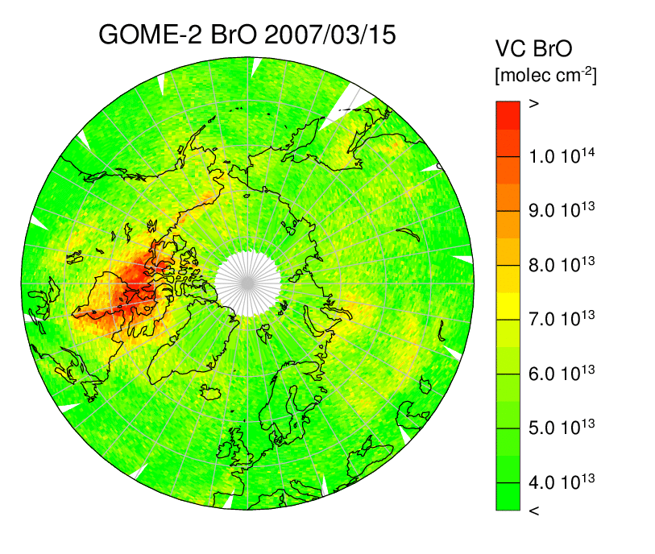
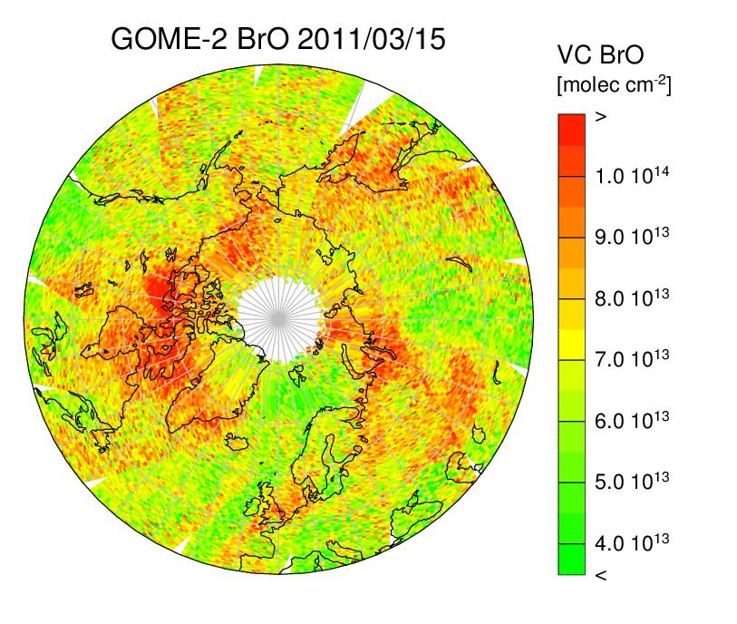
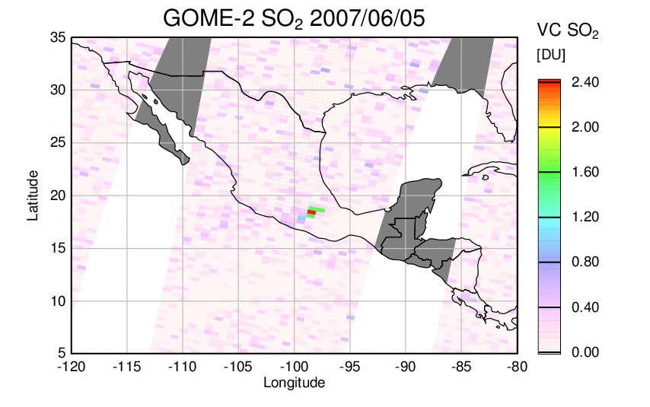
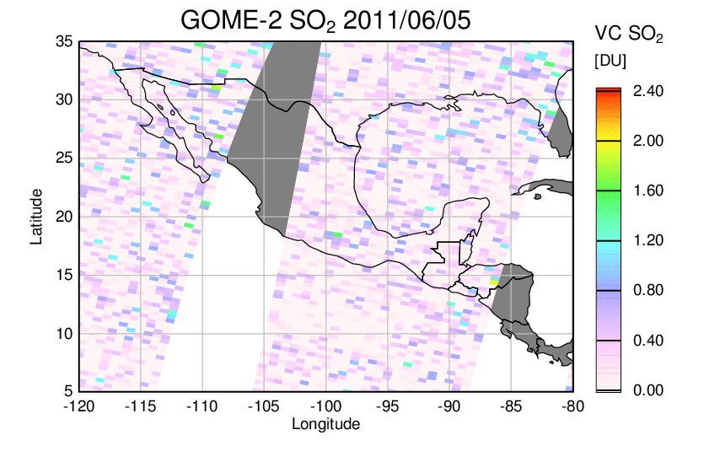
Motivation of GOME-2 Reprocessing
At beginning of mission
After 4 years of operation
Notes:
GOME-2 is used for the monitoring of ozone and a many other trace gas columns and profiles.
Over the first 4 years of the mission instrument aging led to problems in the shortwave channels 200-275 nm used for BrO and SO2 retrievals.

Slide 9
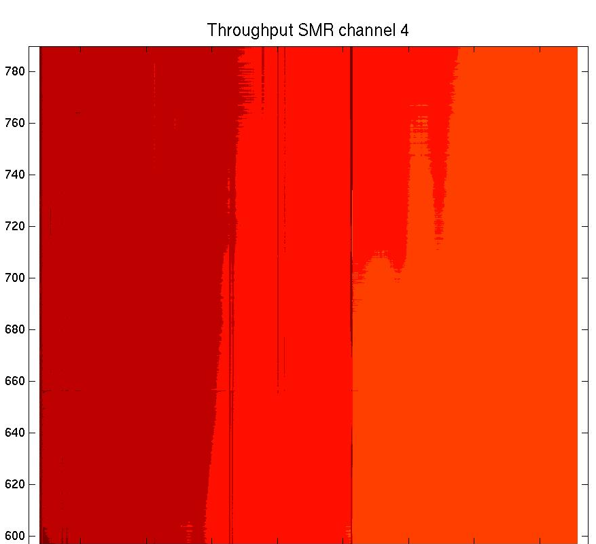
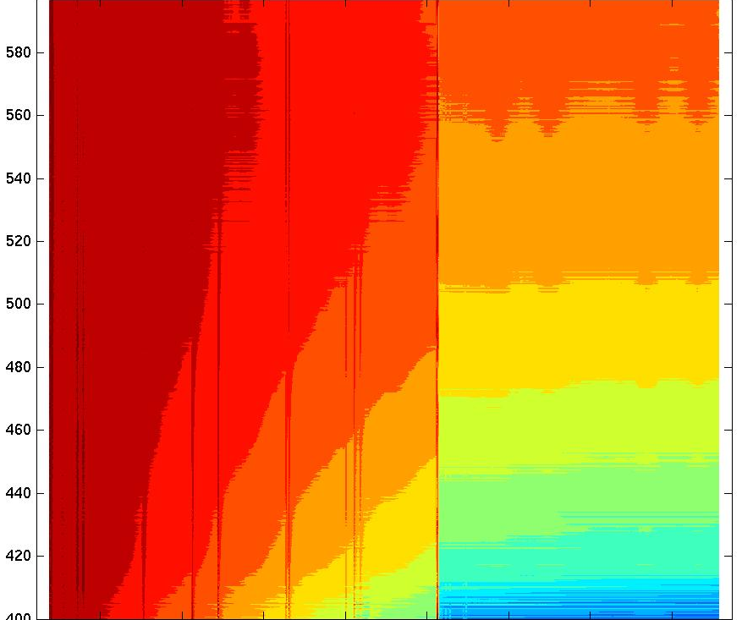
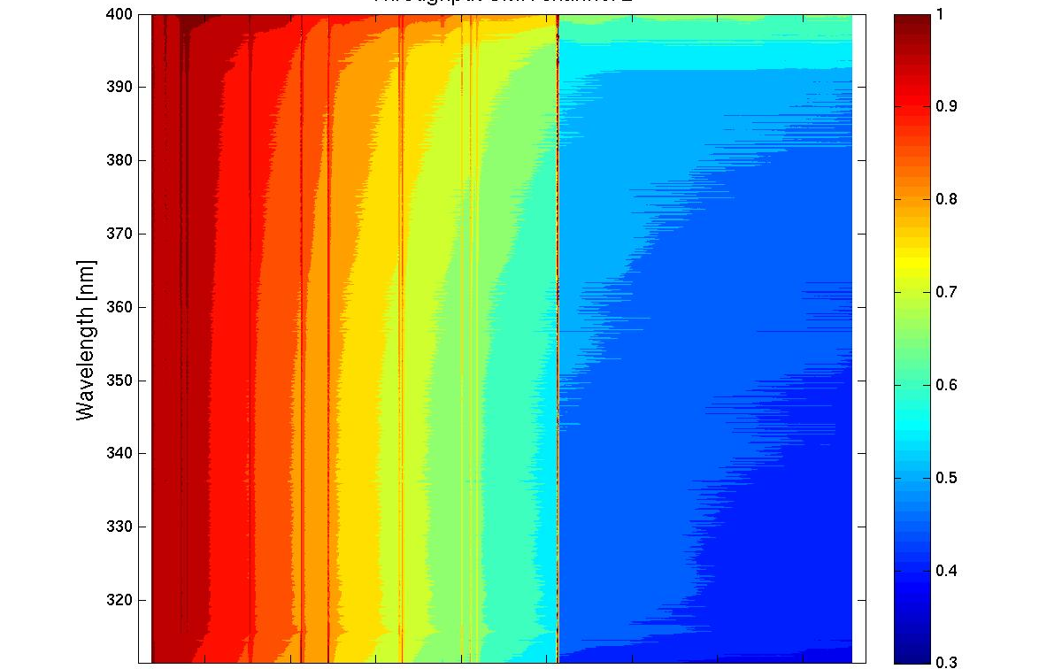
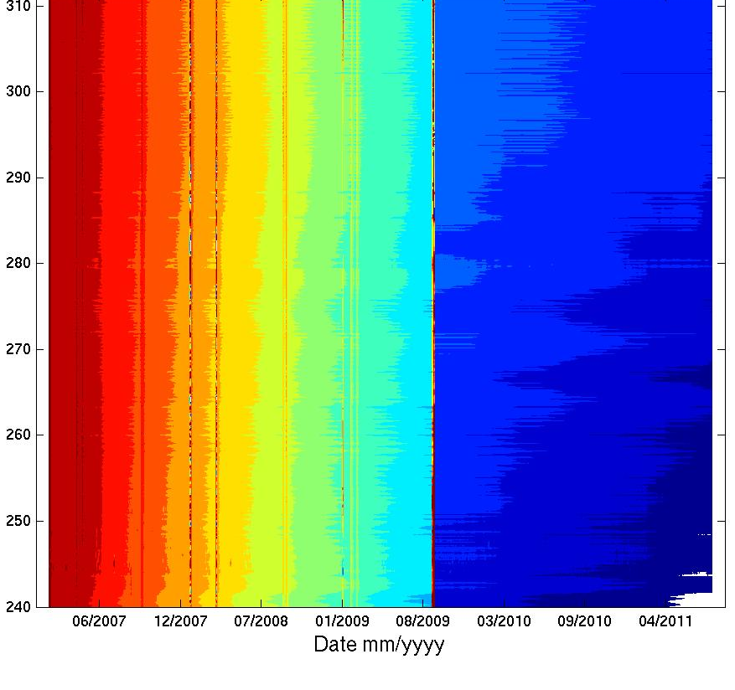
GOME-2 Long-term throughput changes
Solar Mean Reference (SMR) spectrum
240 nm
790 nm
Feb. 2007
Aug. 2011
0.3
1.0
Slow onset of degradation observed after 2nd throughput test in channel 1 and 2.
Instrument is stable now in channel 3 and 4.
Reprocessed signals R2 PPF 5.2 until August 2011
relative to February 2007
Notes:
Reprocessing campaign R2 for level 1 data January 2007 to August 2011
Main objective: Evaluation of a 3D (spectral, temporal, scan angle) degradation for both earthshine and solar mean reference;
Updated throughput monitoring;
Derivation of offline degradation characterization matrix (“Level 1B to C processor”) to be provided offline for the reprocessed data set.
Execution of reprocessing campaign R2 covering January 2007 to August 2011 is ongoing 3rd quarter 2011 to first quarter 2012.
Processor version will be 5.2 with Product Format 12.0 (new format);
Data will be delivered as ANX-to-ANX orbits (not Svalbard to Svalbard)!;
Data delivery: Q2/2012;
Media for full set: LTO-4 tapes.

Slide 10
Atmospheric Profiling by Radio Occultation (RO)
METOP
Vertical profile of bending angle due to refraction and extinction of the signal along the path.
t₁
t₂
t₃
GPS
Notes:
We already use the operational GPS-RO bending angles in ERA Interim and we have recently published a paper showing the impact (Poli et al, 2010).
GPS-RO cleaned up stratospheric biases in ERA Interim in the same way it did in operations.
One of the most important measurement GPS-RO measurement characteristics in this context, is that the measurements are unbiased and therefore different in instruments should have the same characteristics. Instruments should be interchangeable, without the need for overlap periods for calibration.
At the ECMWF/GRAS SAF seminar in June 2008, we were able to show that the COSMIC/GRAS bending angle (o-b) biases differed derived from operations. The difference was small, only ~0.2-0.3%, but it was noticeable in the bending angle statistics. Bending angles are not the raw measurements, they require some pre-processing, but this was a surprise.
EUMETSAT (Christian Marquardt) and UCAR (Sergey Sokolovskiy) identified the cause (how the phase delays were being smoothed in the processing) in early 2009, and a change to the operational COSMIC processing was made in October 12, 2009. We can see from the long ERA Interim time series how the COSMIC/GRAS bias (o-b) biases have converged since this change. ERA Interim is useful, because the NWP system is constant. The GRAS biases have changed because the mean state has changed as a result of the COSMIC changes.
Important for climate/reanalysis applications.
Value of workshops bringing NWP users and data providers together!!
Obviously, we will be using reprocessed COSMIC data for the next ERA CLIM reanalyses.
Generally,
As the time series of the GPS-RO measurements grows we can anticipate that GPS-RO observations will have an increasingly prominent role in climate monitoring and reanalysis applications.

Slide 11
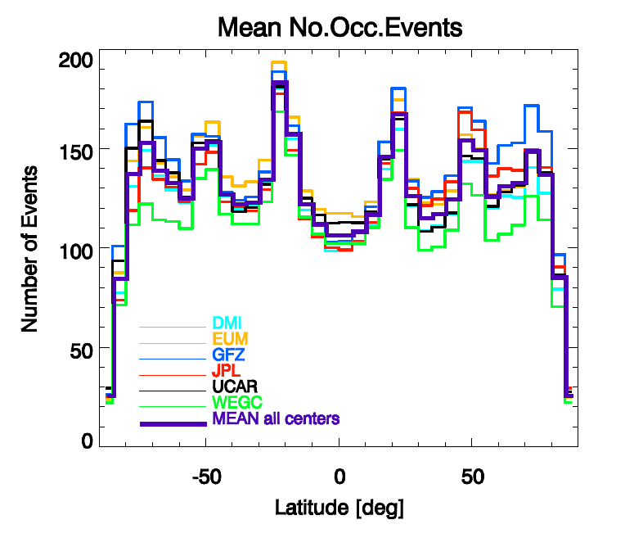
Successfully Processed Occultations
Number of occultations per 5 deg latitude bin in 8 year CHAMP reprocessing comparison (09/2001 – 09/2008); “ROTrends”);
All retrievals based on identical Level 0 data;
Numbers depend on QC, but also on processing glitches at various centres.
Stricter QC / less profiles does not necessarily mean better quality data.
A.K. Steiner et al. IROWG 2012
Notes:
number of successfully processed occultations from a single satellite (CHAMP)
over 8 years (Sep 2001 - Sep 2008)
- significant differences in the number of successfully processed data (up to 33%)
mostly due to different approaches to QC, possibly also to glitches in processing
systems
- Our view: Stricter QC / less profiles does not necessarily mean better quality
data
- Our view: With GRAS, EUM continuous to deliver most profiles from all centres

Slide 12
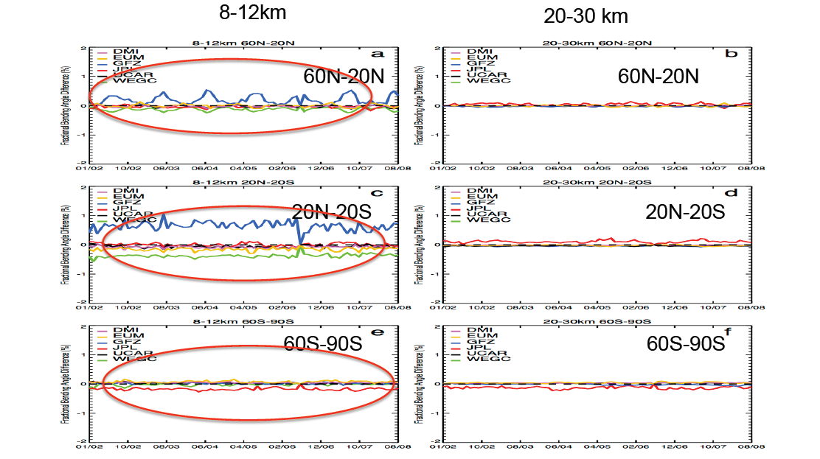
Bending Angle Consistency
S.P. Ho, UCAR
Time series of relative bending angle anomalies from global inter-centre mean in 8 year CHAMP reprocessing comparison (09/2001 – 09/2008); “ROTrends”);
All retrievals based on identical Level 0 data;
Excellent agreement in lower stratosphere (20 – 30km), but larger deviations below and above (due to differences in processing; upper level deviations not shown).
Notes:
Slide 3, ROTrends study (Shu-Peng Ho, UCAR, Boulder)
- Time series of bending angle deviations from inter-centre mean from the same
period calculated on a profile-by-profile comparison
- consistent in lower stratosphere (20-30 km),...
- ...but significant systematic deviations outside that core range, especially
in troposphere (even higher up - not only where humidity makes RO difficult!)
Overall
- differences are very small (a few 0.1 %)
- sweet spot or RO (20-30 km) is by now very consistent between retrieval centres, but
data higher up and lower down show much broader deviations between centers
- numbers of occultations differ between centres, not necessarily indicating that
fewer number of profiles mean better profiles.

Slide 13
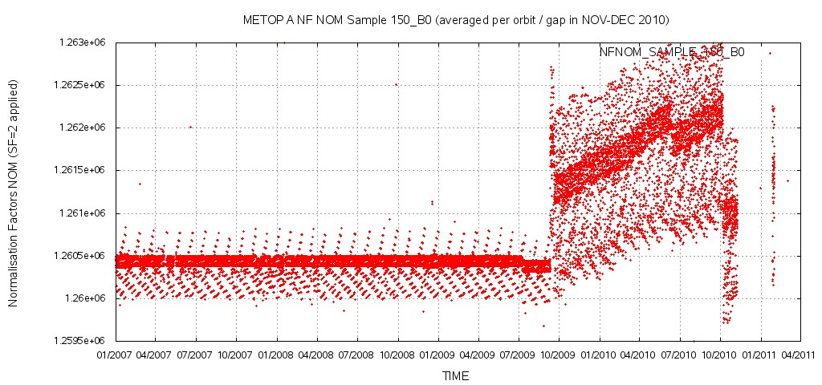
ASCAT L1b Data Record to Date
  Reprocessed Sigma 0 data 2007 – 2008, EC_2007 (*); objective of assessing instrument performance stability
Operational Sigma 0 data 2009 Jan – Sept, EC_2007
After September 2009, major changes in processing configuration and instrument calibration:
    Operational data 2009 Sept – Aug 2011, EC_2007, dynamic calibration, non-frozen eccentricity orbit, Mid Left Beam calibration change;
    August 2011 – today, EC_2010.
manoeuvres
Static calibration
0.002 dB
Dynamic calibration
Notes:
(*) EC stands for External Calibration campaign carried out from ground transponder measurements
Other events influencing the consistency of the data record are the manoeuvres, but effects in the data quality are of lower order of magnitude w.r.t. calibration changes
Phase 2 reprocessing planned for sigma0 (CAF), winds and soil moisture (SAF) back to January 2007. Planned for 2013.
Main driver: consistent ASCAT geophysical data records for ERA CLIM
Scope: Agreement at ASCAT Science Advisory Group level on the Reprocessing Product Requirements
Pre-condition: Validation of calibration results over natural targets (ocean and land)
Note however that the current OSI SAF L2 wind data record has been processed by handling all the L1b configuration and calibration changes. This means that record data changes are due to L2 processing configuration changes, to actual instrument changes or to the natural variability of the ocean
The requirements on the climate data record accuracy and stability are formulated on geophysical parameters over natural targets (e.g. winds over ocean, soil moisture over land, ice coverage)
On the other hand, the radar backscatter is the reference property of the Earth surface which can be most directly related to the measurement system. Therefore, our first goal is to provide a consistent radar backscatter record, and to be able to monitor it independently of natural targets (transponder calibration campaigns).
We need to ensure that measurement system changes estimated independently can be validated and are understood in terms of observability over natural targets, in order to be able to give estimates on the accuracy and stability of our geophysical data records
Validation of calibration results over natural targets is going to be our next challenge in preparing for the next reprocessing effort
On the positive side, the radiometric accuracy under discussion is beyond what the measuring system was specified to provide!

Slide 14
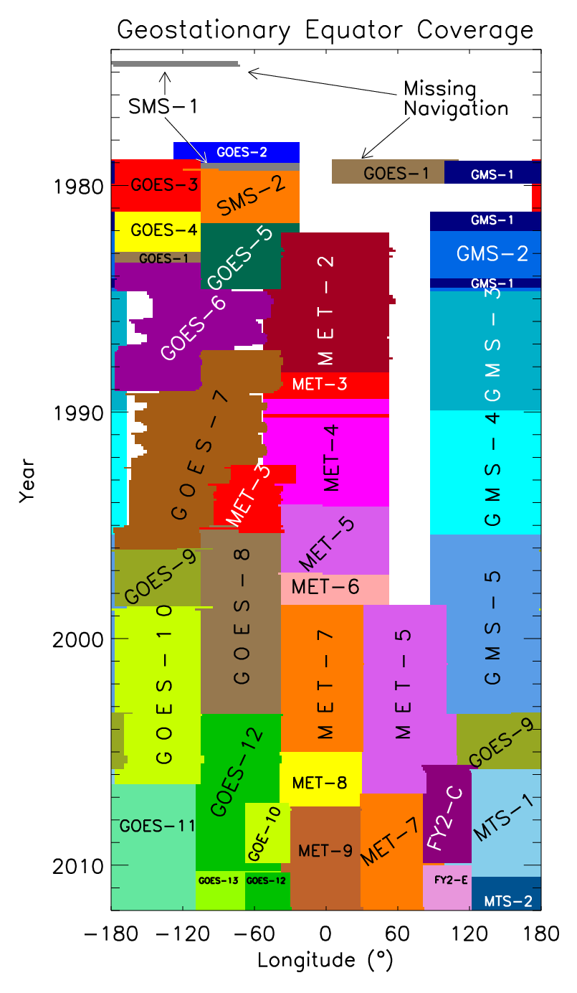
FCDR Creation - Scale of the Challenge
ISCCP
International community has embarked on the creation of FCDRs for archived data (EUMETSAT, NOAA-CDR program and similar programs);
Inter-calibration of the sensors to allow seamless products is a weakness in existing data records, e.g., GEWEX data projects and CSR products for reanalysis;
We started to inter-calibrate the Meteosat IR and WV and quantifying the uncertainties using IASI as reference;
Space agencies work in GSICS and SCOPE-CM frameworks to achieve the inter-calibration for the whole tapestry.
Figure: Courtesy of Ken Knapp, NOAA-NCDC
Notes:
Figure shows the geostationary data (>30 satellites) used for the GEWEX ISCCP data records. Using IASI and HIRS for inter-calibration of the geostationary instruments means adding ~13 instruments to the list.

Slide 15
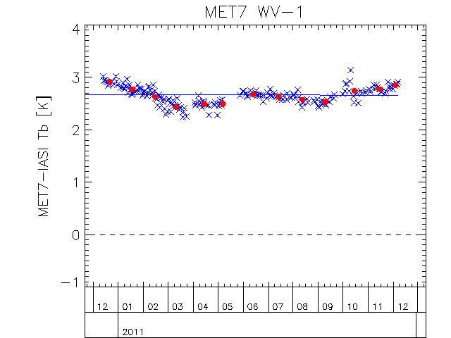
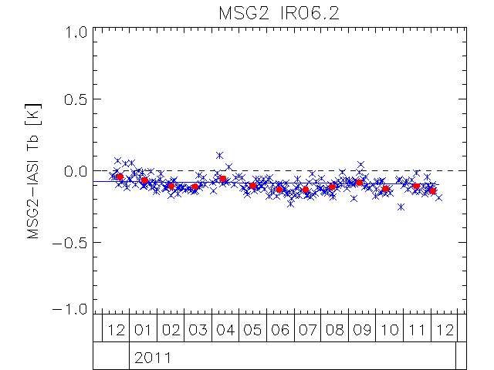
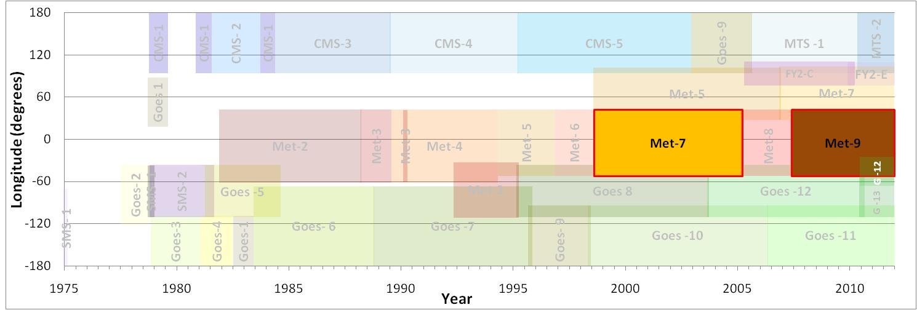
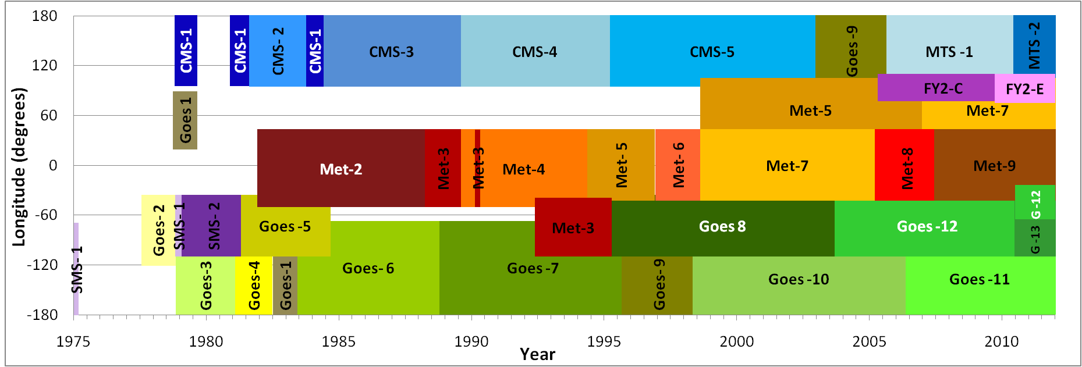
Scale of the Challenge
Fig: Satellites used for the ISCCP climate data record. (Courtesy of Ken Knapp, NOAA-NCDC)

Slide 16
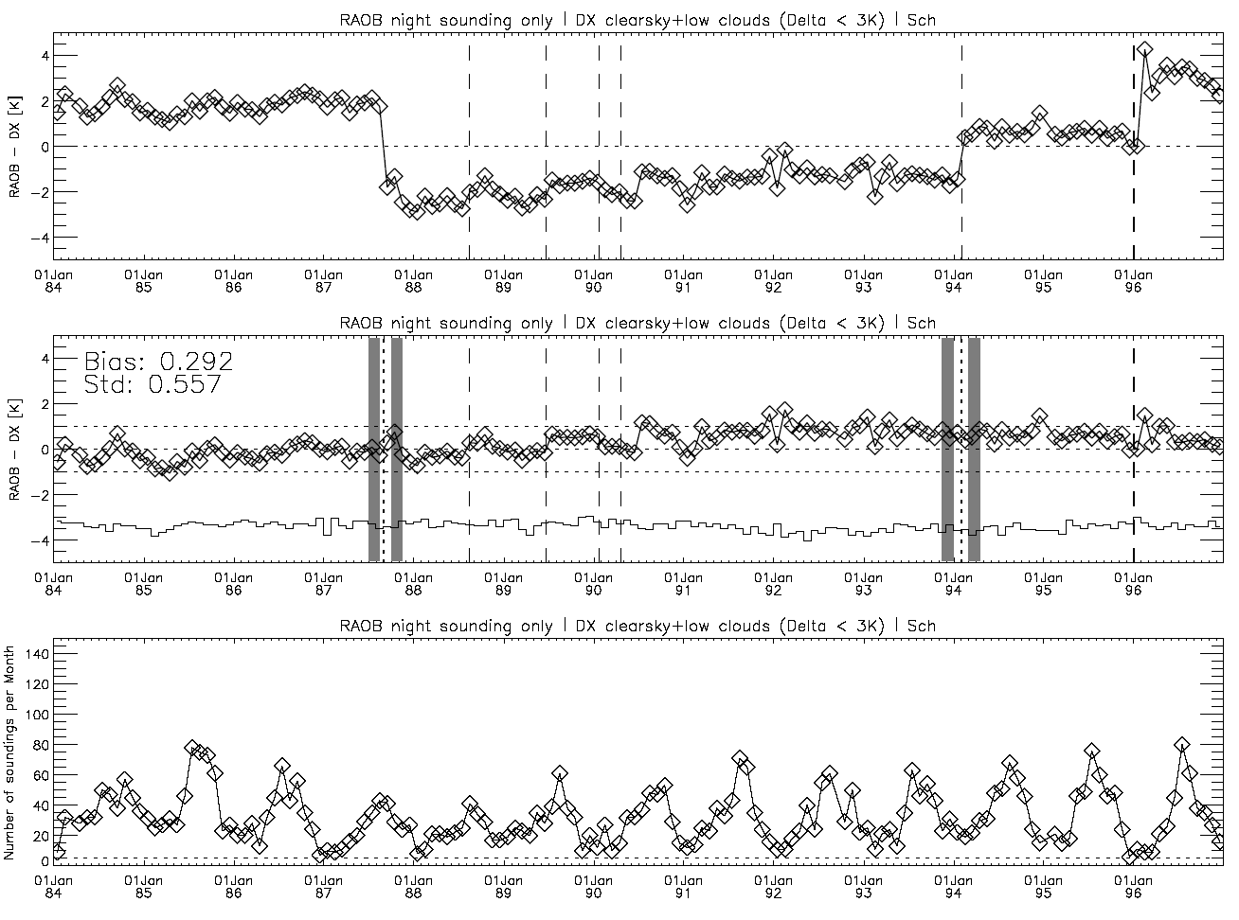
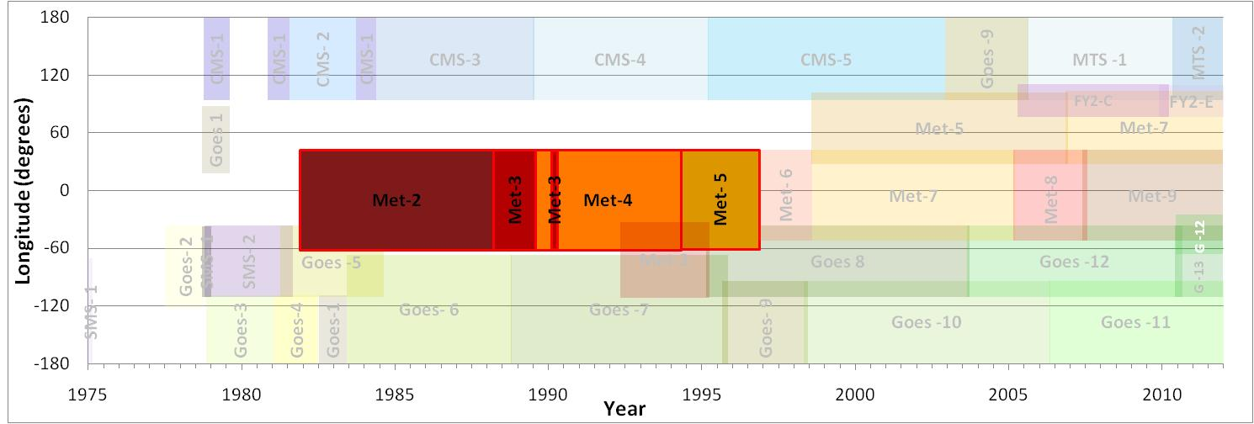
Scale of the Challenge
Figure: Courtesy of Rémy Roca, LMD
MET2
MET3
4
3
MET4
Original
MET5
Calibration changes
Instrument changes

Slide 17
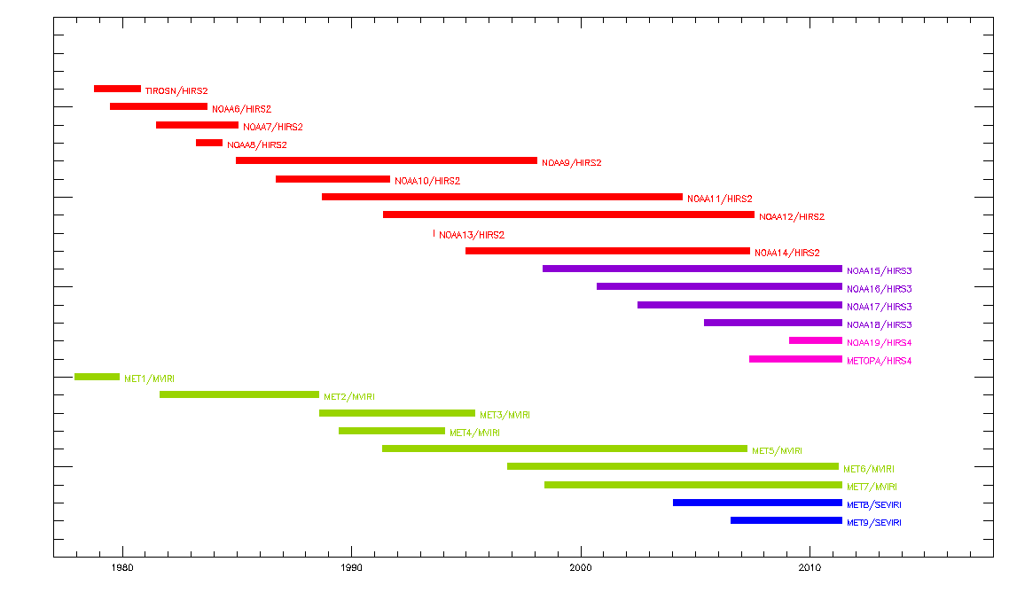
The Zipper Model of Transferring References
  Use Meteosat as transfer standards to inter-calibrate HIRS and v.v.
Delta Correction to transfer from one reference to another
Defined as differences between inter-calibration functions
Defined in channel-space of monitored instrument
No need for direct comparisons of references
Uncertainty
due to spectral conversion,
SNO noise and instrument and orbit drift
Schematic only!
MetopA/HIRS4/ IASI
Delta
METOPB/HIRS4/ IASI
Delta time steps inserted for illustration only
In practice, deltas defined from simultaneous double-differences
Notes:
Objective:
To recalibrate time-series Meteosat First Generation and Meteosat Second Generation infrared radiances from 1982 till date using an external reference (polar orbiting sounders).
Prerequisites:
Inter-calibration back to 1982
Target accuracy over the time-series better than 1 K
Inter-calibration with uncertainty estimate
Method
Define reference instrument and standards (HIRS and ultimately IASI)
Define the inter-calibration approach
Estimate the uncertainties (spectral conversions, reference drift, calibration transfer uncertainty (e.g. for SNOs)
Reprocess, verify and validate the re-calibrated data record
Benefits of HIRS as reference:
Established instrument
Operated by NOAA since late 1970s
Successfully used in climate monitoring
Similar channels as Meteosat
Includes on-board calibration
HIRS/4 on same platform as IASI, i.e., we can well characterise it against IASI

Slide 18
Uncertainties due to Spectral Conversion for Each Class of Instrument: WV
Monitored➔ Reference ⬇ | HIRS/2 NOAA6-14 | HIRS/3 NOAA15-17 | HIRS/4 NOAA18-MetopB | MVIRI Meteosat 2-3 | MVIRI Meteosat 4-7 | SEVIRI Meteosat 8-11
HIRS/2 NOAA6-14 | 0.04 | 1.03 | 1.07 | 0.07 | 0.16 | 0.41
HIRS/3 NOAA15-17 | 0.78 | 0.05 | 0.06 | X | 0.67 | 0.51
HIRS/4 NOAA18-MetopB | 0.84 | 0.06 | 0.03 | X | 0.74 | 0.57
Mean RMSD Tb [K] of Spectral Conversion Functions
for each class of instrument: WV
  Also need to:
  Estimate Calibration Transfer Uncertainty (e.g. by SNO)
  Estimate drift in reference transfer standards
Notes:
Objective
To develop Spectral Conversion Functions to account for Spectral Response Function differences and select which HIRS channels represent the MFG and MSG infrared channels best.
Method
Restricted evaluation to a sounding (~6μm) and a window (~10μm) channel;
MFG, MSG and HIRS brightness temperatures are calculated for a selection of ECMWF profiles (from Chevallier 2001) using RTTOV;
Uncertainties are assessed for three conditions: all latitudes, all sky, two angles (nadir and 60°);
HIRS channels that fit best to MFG or MSG are determined by assessing different fitting methods and using RMSD as a verification metric

Slide 19
Conclusion
EUMETSAT provides long term continuity of space observations – A key for the generation of Climate Data Records and Reanalysis input.
EUMETSAT generates data records from own and third party missions utilising its Central and Satellite Application Facilities that shall benefit reanalysis activities;
The ERA-CLIM project has helped to speed up activities at EUMETSAT;
Activities towards referencing Meteosat IR and WV channels to IASI/HIRS are underway using a traceable chain of inter-calibrations. Further analysis of uncertainties is needed – The ERA-CLIM feedback archive will play a major role in this as well.
The EUMETSAT SAF network has committed more work on CDRs in their CDOP-2 project phase (2012-2017), e.g., microwave humidity (183 GHz) FCDR, new versions of sea ice concentration and other atmospheric, oceanic and land data records.

